Slide 1
Hands-on
A morphologically-detailed neural network simulation library for contemporary high performance computing architectures
12th December 2018 I Anne Küsters & Alexander peyser

Slide 2
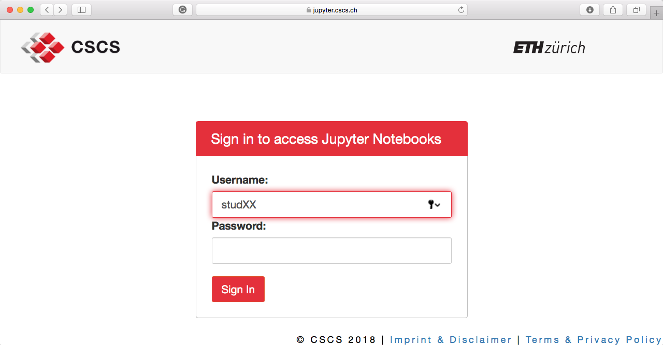
Preparation
Sign in to https://jupyter.cscs.ch with your training username and password

Slide 3
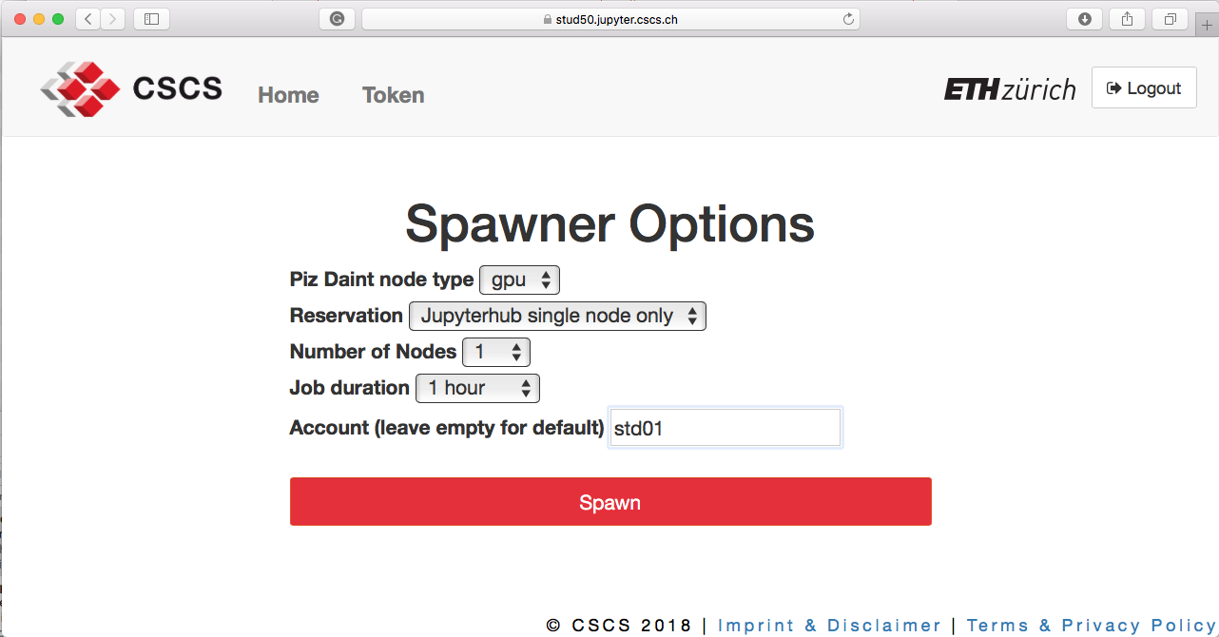
Preparation
Spawn a GPU with reservation of one node for one hour using Account std01

Slide 4
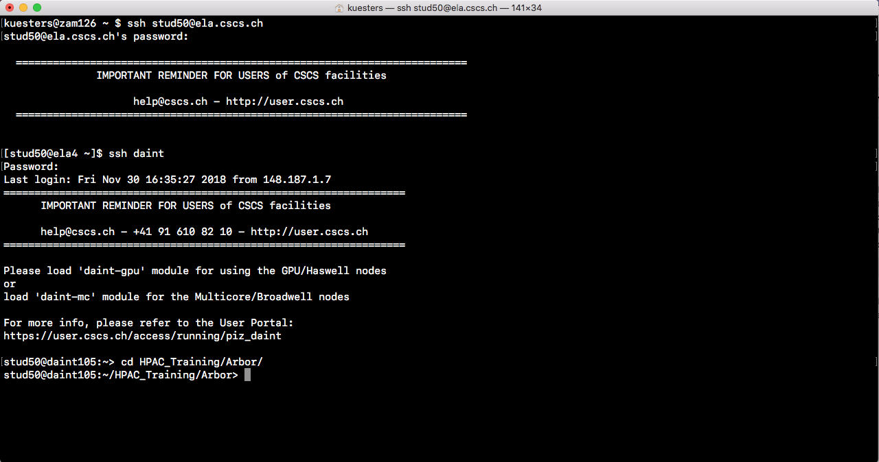
Preparation
Log in to trainings account on Ela via ssh ela.cscs.ch and then on Daint via ssh daint and cd to Arbor

Slide 5

ORGANIZATION and work-flow
4 tasks, each dependent on the previous
Structure:
On your training account, go to:
HPAC_training → Arbor
handson → Jupyter → exercises
0X_exercise (where X is the exercise number 1-4)
Here, you find a python script with your #TODO#
Each exercise builds up on the previous exercise
Work on your TODO`s and save your solution to the next exercise folder
In case your solution does not work (after really trying and asking tutors), use provided script in next exercise
Source of picture: flaticon.com

Slide 6
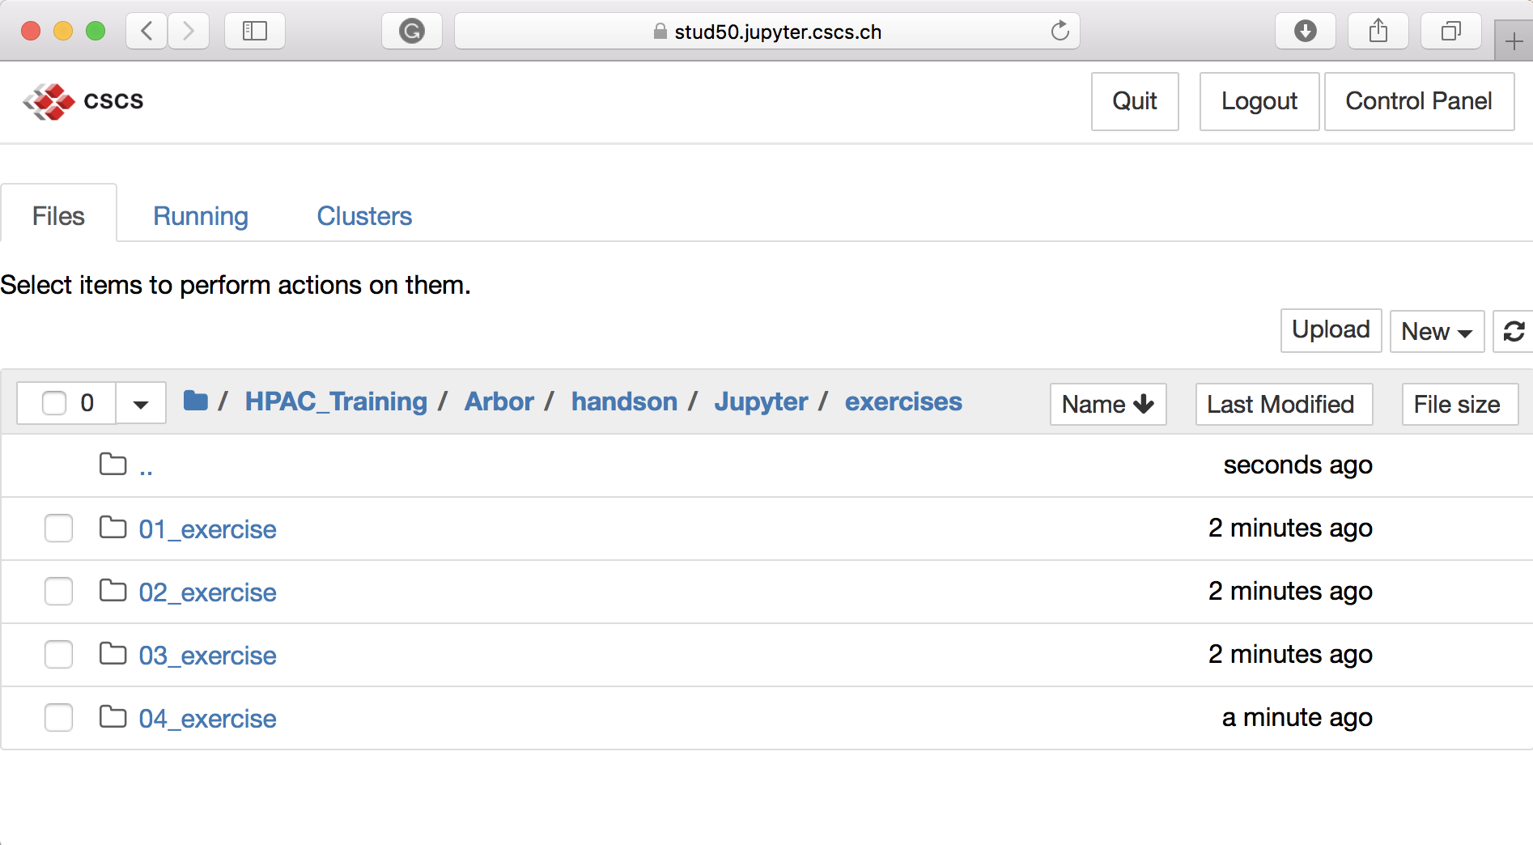
ORGANIZATION and work-flow
4 tasks, each dependent on the previous

Slide 7
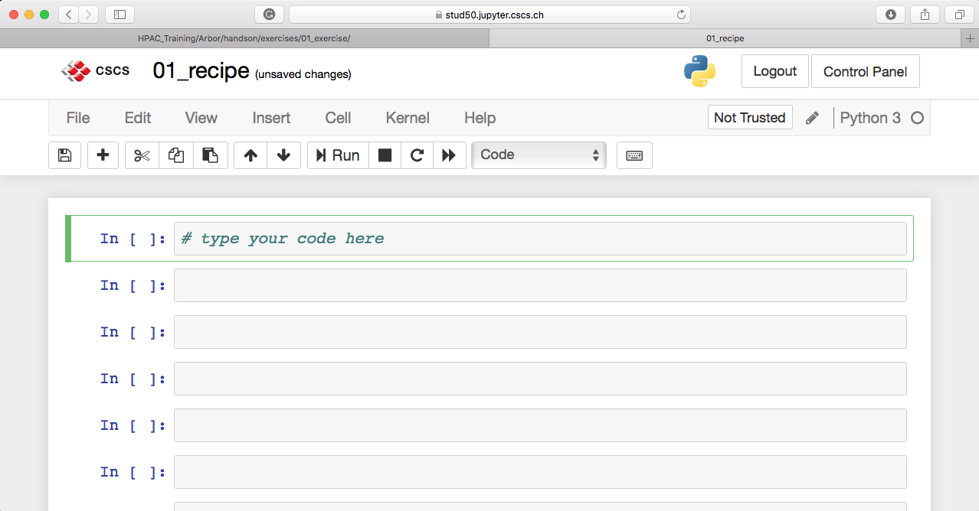
Short Introduction of jupyter notebooks
Easy to use
Save
Restart kernel
Insert cell
Run cell
Move cell

Slide 8
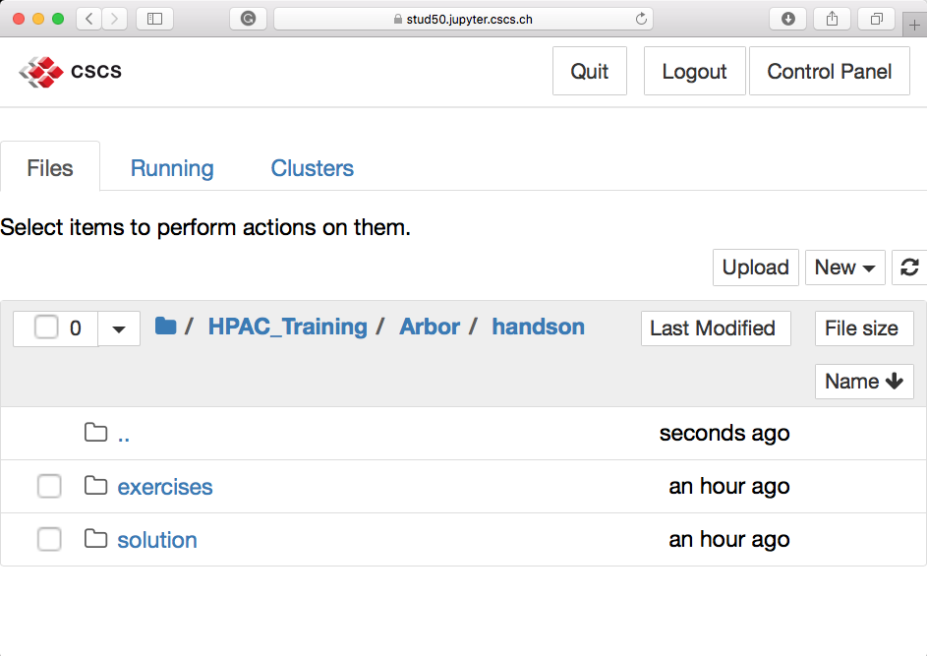
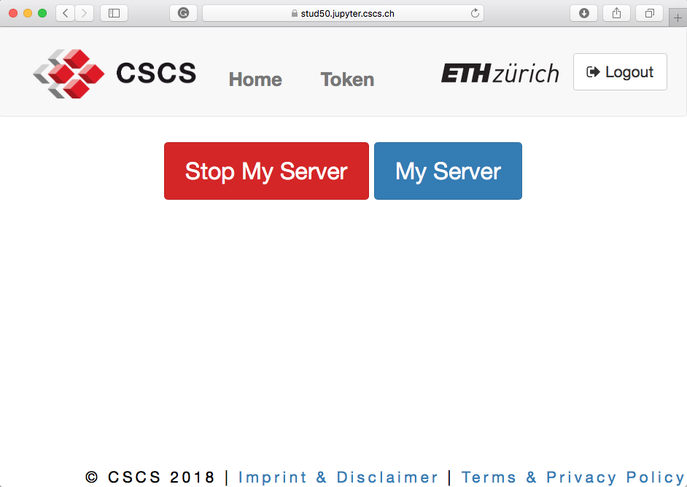
Short Introduction of jupyter notebooks
End your session via “Control Panel – Stop My Server” after completing the tasks
Control Panel
End session

Slide 9



Overview of exercises
Exercises follow steps to setup and run a simulation with Arbor`s python frontend
Describe neuron model by defining a recipe
Get the resources, create the parallel execution context and part the work into segments by partitioning the load balance
Initiate the simulation over the distributed system and run the simulation
(OPTIONAL: Set up measurement meters, get spike recorder and its spikes to print meter report and spike times of the cells)
Source of pictures: flaticon.com
Notes:
Flaticon.com

Slide 10
Recipe
Distinction between the description of a model, and the execution of a model (simulation)
A recipe is a description of a model. The recipe is queried during the model building phase to provide cell information, such as:
the number of cells in the model as input argument (num_cells)
the type of a cell (kind)
a description of a cell with soma, synapses, detectors, stimuli (cell_description)
optionally, e.g.:
the number of spike targets (num_targets)
the number of spike sources (num_sources)
incoming network connections on a cell (connections_on)

Slide 11
Task 1: Create a recipe for ring network
Make a soma cell with Arbor`s make_soma_cell()
Add a synapse to the cell with the cells`s function add_synapse() which takes a location, here at segment 0 position 0.5, using Arbor`s segment_location(segment,position)
Add a detector to the cell with the cells`s function add_detector(location,threshold) with a threshold of 20 mV
Add a stimulus to the cell with gid 0 at t₀=0 ms for a period of 20 ms with weight 0.01 nA using the cells`s function add_stimulus(location,start,duration,weight)
Define the source as the previous cell with gid-1, baring in mind that the cell with gid 0 has the last cell in the ring network with num_cells as source

Slide 12
Hardware resources
Arbor supports running on systems from laptops and workstations to large distributed HPC clusters
Therefore, Arbor uses distributed contexts to
Describe the computer system that a simulation is to be distributed over and run on.
Perform collective operations over the distributed system.
Query information about the distributed system.
The global context is determined at run time taking the computational resources as input. Further, the user can choose between using a non-distributed (local) context, or a distributed MPI context (if available).
An execution context is created by a user before building and running a simulation. This context is then used to perform domain decomposition and initialize the simulation.

Slide 13
Domain Decomposition and Load Balancing
Arbor is performance portable
A domain decomposition is a description of the distribution of the model over the available computational resources. The description partitions the cells in the model as follows:
Group the cells into cell groups of the same kind of cell.
Assign each cell group to either a CPU core or GPU on a specific MPI rank.
A load balancer is a distributed algorithm that
Determines the domain decomposition to balance the work over threads (and GPU accelerators if available).
Uses the model recipe and a description of the available computational resources as inputs.

Slide 14
Task 2: Create parallel execution context
Get all available local hardware resources by using Arbor`s proc_allocation().
Create a context by using Arbor`s context() that uses the local resources, and an MPI communicator for distributed communication.
Initiate the recipe() defined in task 1 with 100 cells.
Partition the simulation over the distributed system by using Arbor`s partition_load_balance() that uses the recipe and the context handle.

Slide 15
From Recipe to Simulation
A simulation needs a recipe, a context and a domain decomposition
To build a simulation the following are needed:
A recipe that describes the cells and connections in the model.
A context used to execute the simulation.
Thereof, a domain decomposition describing the distribution of the model over the local and distributed hardware resources.
The workflow to build a simulation is, thus, to first generate a domain decomposition, then initiate the simulation that is the executable form of a model. A simulation is initiated from a recipe, the decomposition and the context. Then the simulation is used to update and monitor the model state.

Slide 16
Task 3: Build and run the simulation
Initiate the simulation by using Arbor`s simulation() which takes the recipe, the domain decomposition and the context.
Run the simulation using the simulation`s command run() for a simulated time of 2000 ms with a time stepping size of 0.025 ms.

Slide 17
OPTIONAL: Meter measurement and spike record
To measure memory and (if available) energy consumption
For measuring memory (and energy) consumption Arbor`s meter manager can be used. First the meter manager needs to be initiated, then the metering started and checkpoints set, wherever the manager should report the meters. The measurement starts from the start to the first checkpoint and then in between checkpoints.
Checkpoints are defined by a string describing the process to be measured. The meter report finally collects all meters.
A spike recorder monitors all spikes recorded by a detector on the cells during the simulation.

Slide 18
Optional Task 4: Measure
Initiate Arbor`s meter_manager() and start measuring by using the meters` start() function that takes the context as input.
Set checkpoints using the meters` checkpoint() function which takes a string and the context as input
„recipe create“ after initiating the recipe
„load balance“ after partitioning the simulation
„simulation init“ after initiating the simulation
„simulation run“ after running the simulation

Slide 19
Optional Task 4: Get results
Between initiating and running the simulation, build the spike recorder using Arbor‘s make_spike_recorder() which takes the simulation handle as input
Make and print a meter report by using Arbor`s make_meter_report() function that takes the meters and the context as input.
Get the recorder`s spikes
Play around with parameters and see what happens.

Slide 20
Summary
Using Arbor`s python frontend
We learned how …
to describe a neuron model using a recipe;
to get resources, create a parallel execution context and partition the load balance;
initiate the simulation over the distributed system and run the simulation;
set up measurement meters, get spikes recorded and print a meter report along with the spiking times of the cells.
Further, we learned how to use and create Jupyter notebooks on CSCS` JupyterHub.

Slide 21
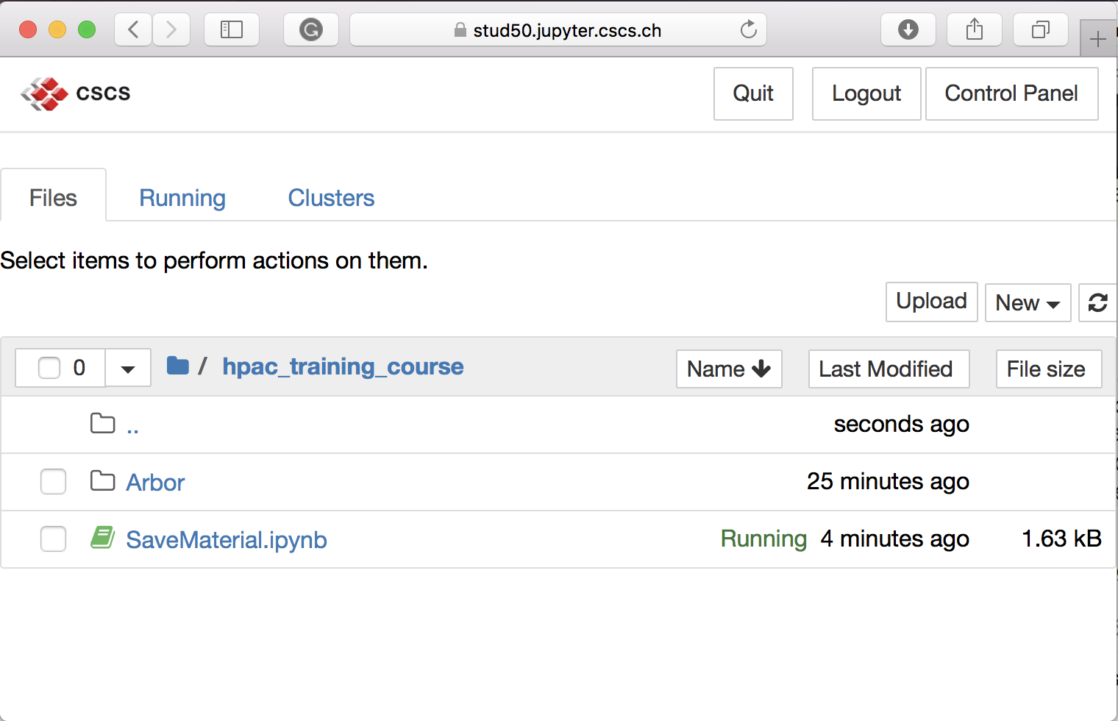
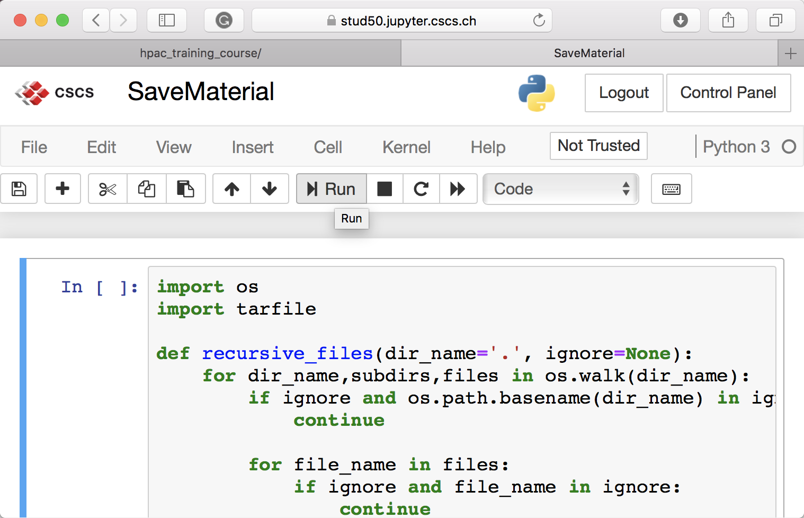
How to download the material
First, run the notebook SaveMaterial.ipynb
Run notebook

Slide 22
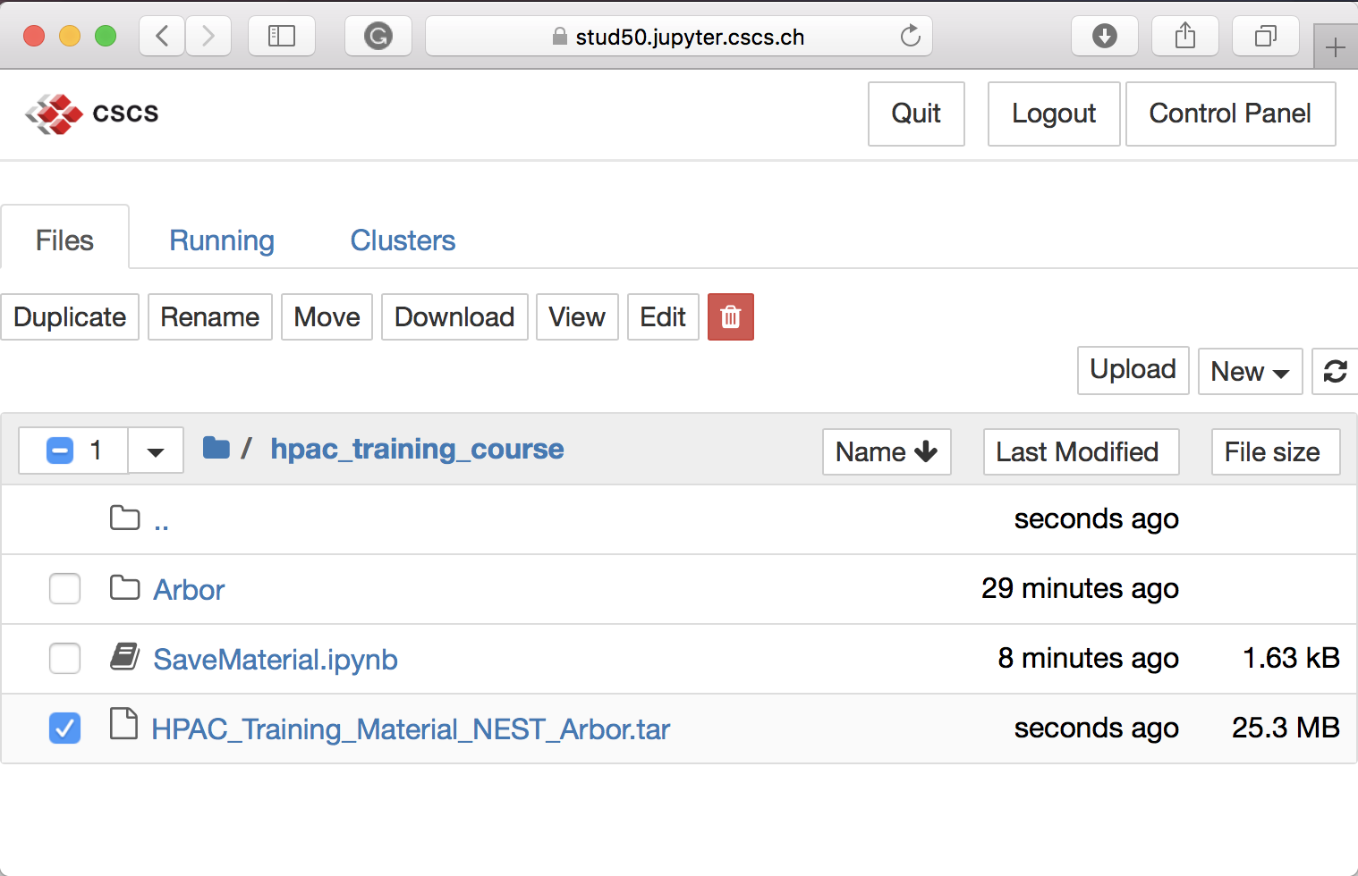
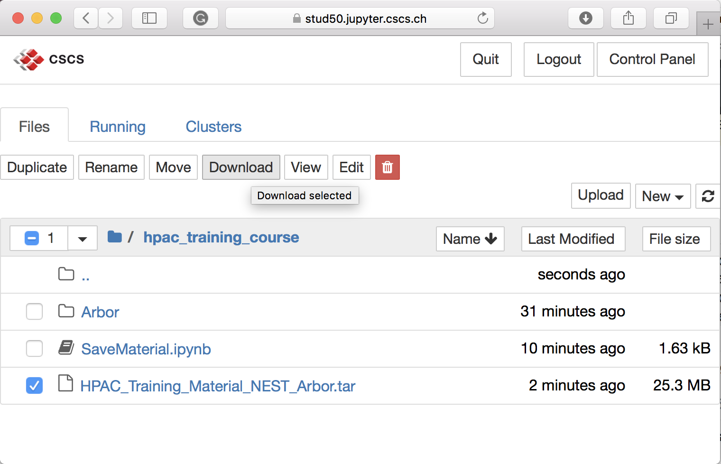
How to download the material
Then, download zipped file
Check box
Press Download

Slide 23
Literature and Links
Arbor – a morphologically-detailed neural network simulation library for contemporary high-performance computing architectures, High Performance Computing for Neuroscience, PDP2019
https://github.com/arbor-sim/arbor
https://arbor.readthedocs.io

Slide 24
BACKUP – Installation guide

Slide 25
Build and Install Arbor from source code
Requirements
Follow steps to use Arbor`s python frontend:
Minimal requirements:
git
cmake
gcc 6/ clang 4/ Apple clang 9
python
mpi

Slide 26
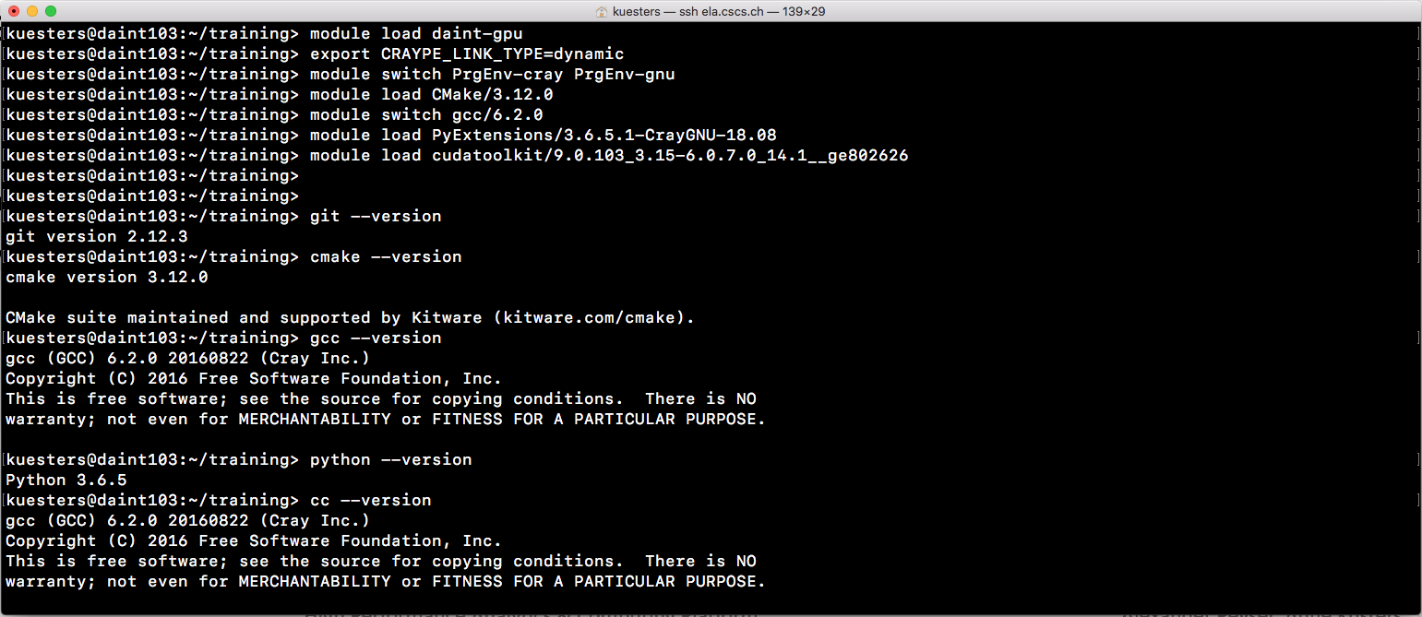
Build and Install Arbor from source code
Load modules
Load modules on Piz Daint

Slide 27
Build and Install Arbor from source code
Clone code
Steps to use Arbor`s python frontend:
Minimal requirements
Clone Arbor`s source code
git clone https://github.com/arbor-sim/arbor.git --recurse-submodules
cd arbor

Slide 28
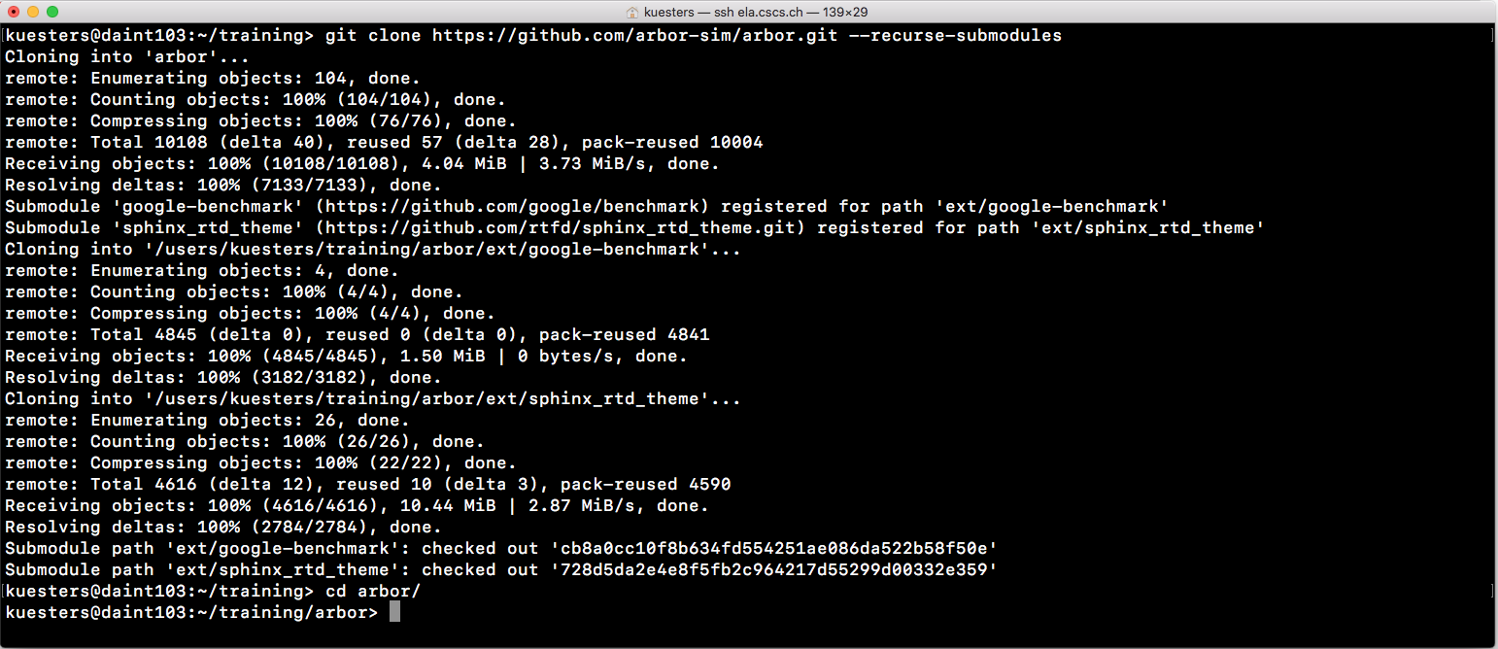
Build and Install Arbor from source code
Clone code
2. Clone Arbor`s source code

Slide 29
Build and Install Arbor from source code
Checkout python branch
Steps to use Arbor`s python frontend:
Minimal requirements
Clone Arbor`s source code
Checkout python branch
git checkout python
git submodule update --init --recursive

Slide 30
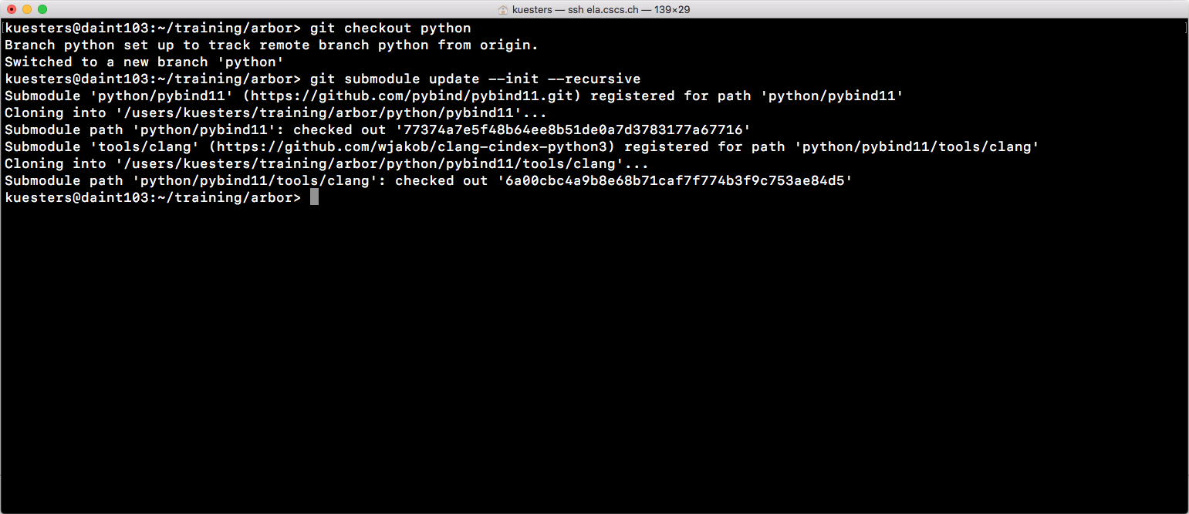
Build and Install Arbor from source code
Checkout python branch
3. Switch to python branch and update submodules

Slide 31
Build and Install Arbor from source code
Prepare environment
Steps to use Arbor`s python frontend:
Minimal requirements
Clone Arbor`s source code
Checkout python branch
Prepare environment
mkdir build; cd build
set CC and CXX
set PYTHONPATH
set CPATH

Slide 32
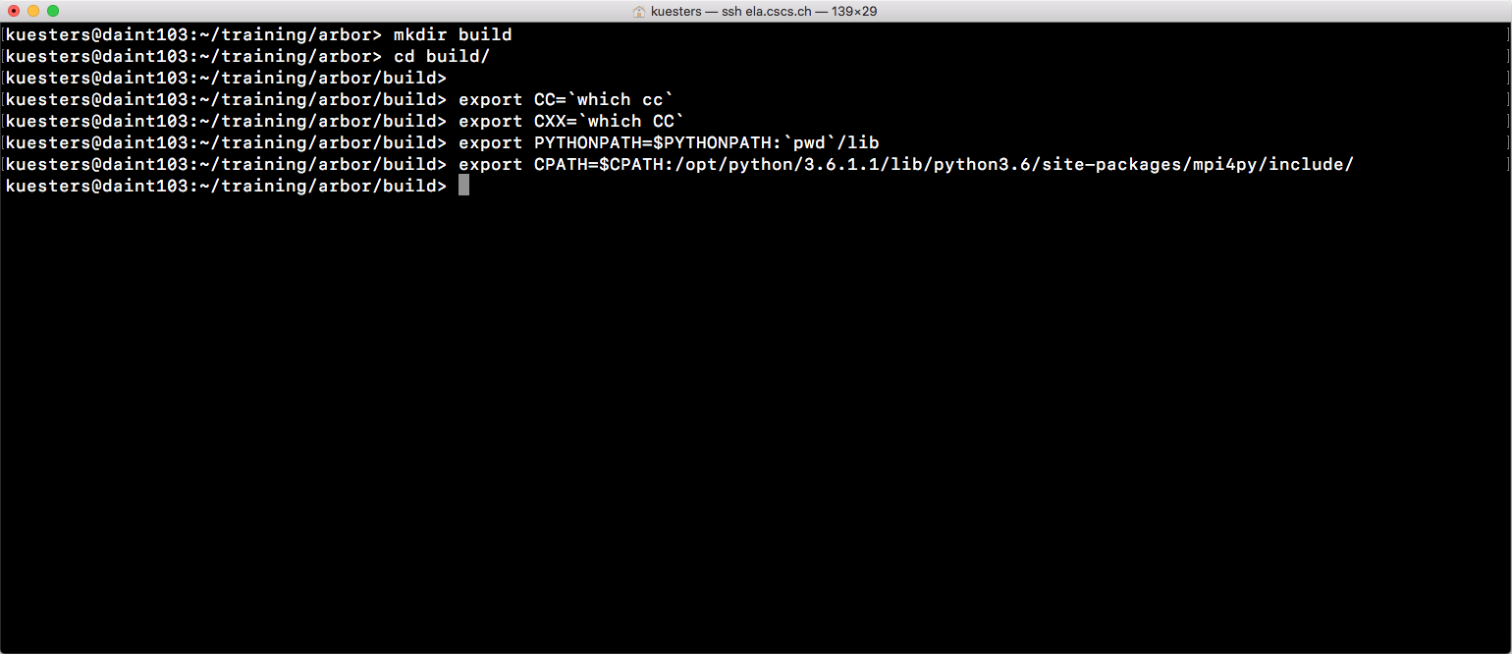
Build and Install Arbor from source code
Prepare environment
4. Prepare environment

Slide 33
Build and Install Arbor from source code
Build
Steps to use Arbor`s python frontend:
Minimal requirements
Clone Arbor`s source code
Checkout python branch
Prepare environment
Build
cmake .. \ -DARB_WITH_MPI=ON \ -DARB_WITH_PYTHON=ON \ -DARB_WITH_GPU=ON \ -DCMAKE_INSTALL_PREFIX=$HOME/training/installation/arbor
make -j8

Slide 34
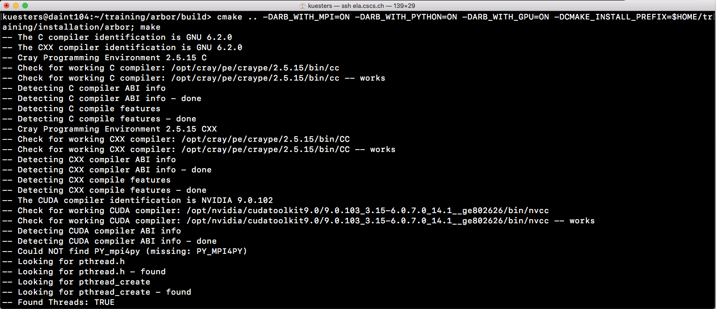
Build and Install Arbor from source code
Build
5. Build Arbor’s python wrapper

Slide 35
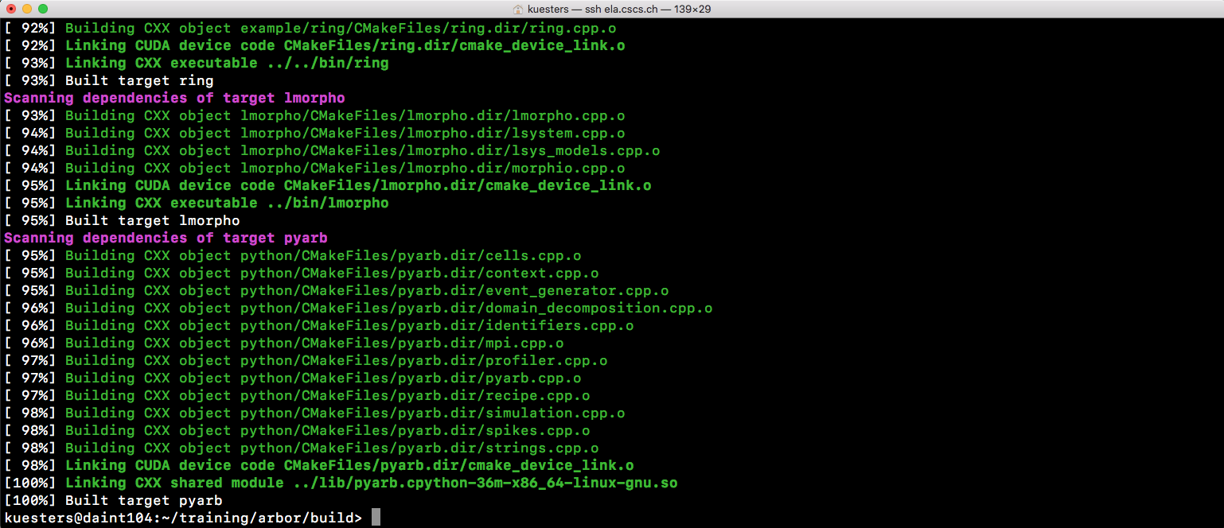
Build and Install Arbor from source code
Build
5. Build Arbor’s python wrapper

Slide 36
Build and Install Arbor from source code
Install
Steps to use Arbor`s python frontend:
Minimal requirements
Clone Arbor`s source code
Checkout python branch
Prepare environment
Build
Install
make install

Slide 37
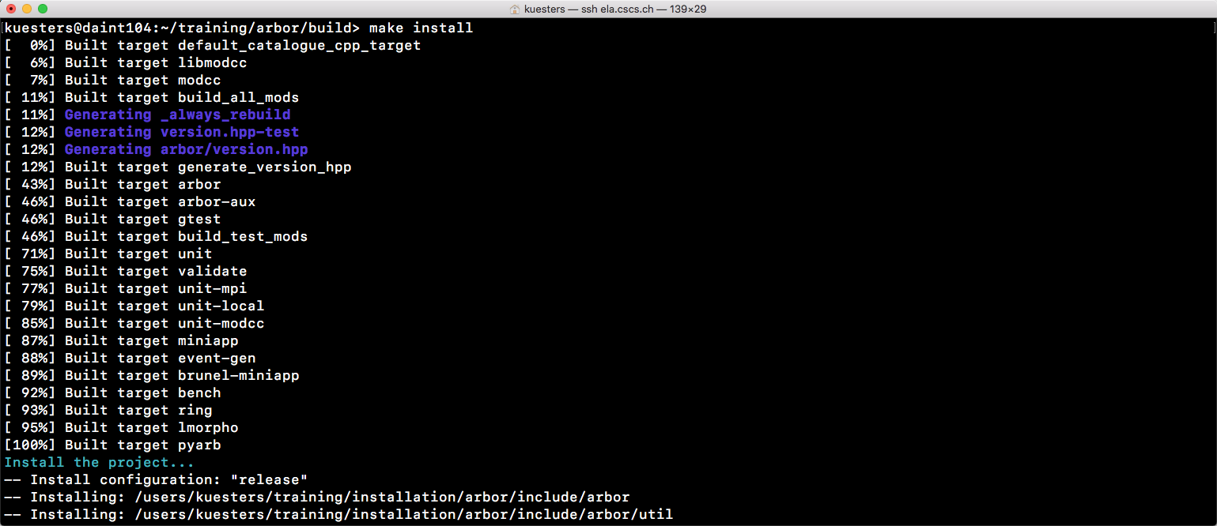
Build and Install Arbor from source code
Install
6. Install

Slide 38
Build and Install Arbor from source code
Test
Steps to use Arbor`s python frontend:
Minimal requirements
Clone Arbor`s source code
Checkout python branch
Prepare environment
Build
Install
Test
salloc -Cgpu -N 4 -t 60
srun -n 4 ./bin/unit

Slide 39
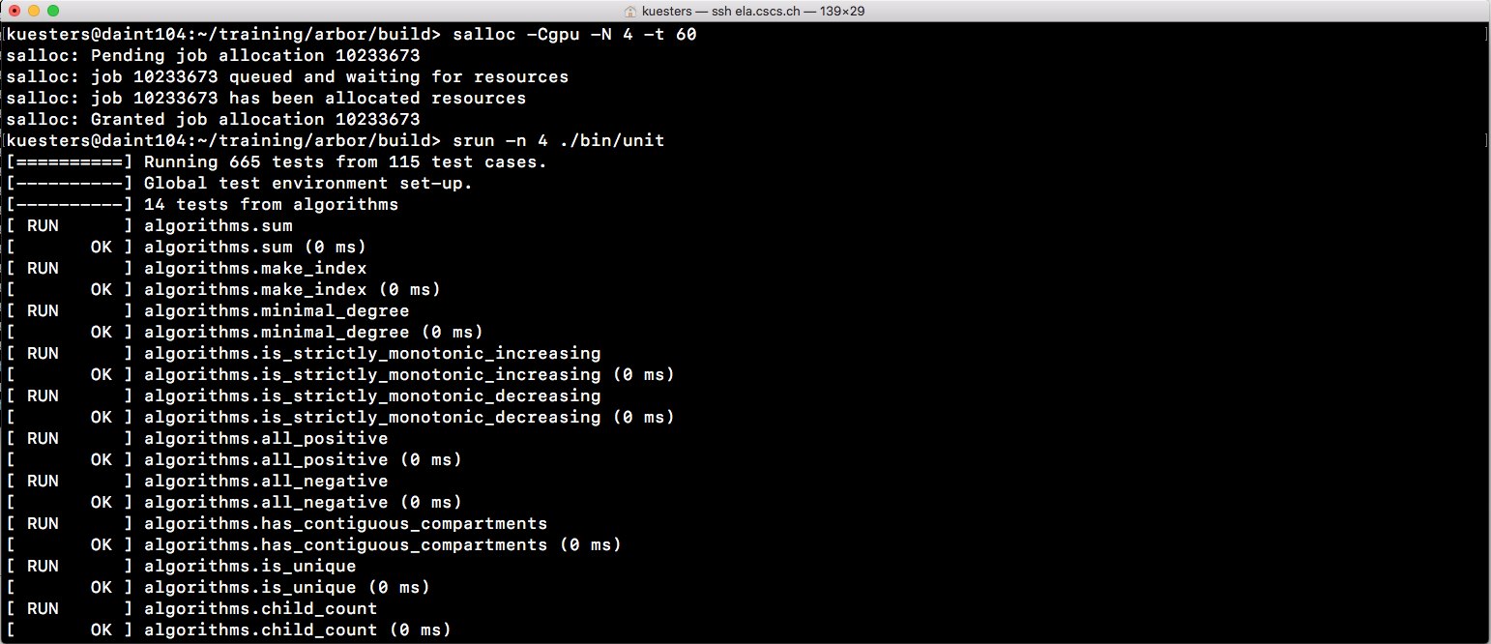
Build and Install Arbor from source code
Test
7. Test – get allocation (e.g. GPU, 4 nodes) and start unit test

